Slide 1
University Ranking Database Project
Team: 06 Team Name: Data Keepers
Batch: 0503
Team Members:
Siddharth Khare
Poojaa Ravi Kumar
Balaji Udayakumar
Arhab Khan
Project Date: 12/03/2023

Slide 2
Background
This database is a valuable resource for both universities and students as it contains a wealth of useful data from multiple sources. Academic stakeholders like faculties, students, ranking organizations and U.S. Department of Education can access rankings from several top university ranking systems in one place. The former are the users we want to target. Sources Used for the database :
US News & World Report Rankings
Times Higher Education World University Rankings
QS World University Rankings
Academic Ranking of World Universities(ARWU)
University websites

Slide 3
Introduction
Mission Statement
Our mission is to design, develop, and implement an efficient and centralized database management system that will provide comprehensive data on comparable programs from diverse sources in USA, with a particular emphasis on the graduate programs offered by the Robert H. Smith School of Business.
Mission Objective
Our project will allow academic stakeholders and prospective students to gain insights into the university ranking data for USA and how it compares with the programs offered by the different Universities in USA (both public and private), aiding them in making better decisions.

Slide 4
Focus Points for Analysis:
Program Ranking vs Ranking Websites: Assess if program rankings vary across different ranking websites.
Dollars per Credit Variation: Evaluate if the cost per credit varies among programs at the Smith School of Business and its impact on rankings.
Program Ranking vs Tuition: Investigate the impact of tuition fees on program rankings and compare with Smith School’s programs.
Acceptance Rate and Program Ranking: Examine if a program’s acceptance rate influences its ranking.
Smith School Ranking vs Peers: Compare the performance of Smith School’s programs with similar programs at other institutions.
Change in Trend: Analyze the change in graduate program rankings over time.
Performance Evaluation: Quantify the quality and standing of the programs offered by the Smith School of Business at UMD considering all the above factors.

Slide 5
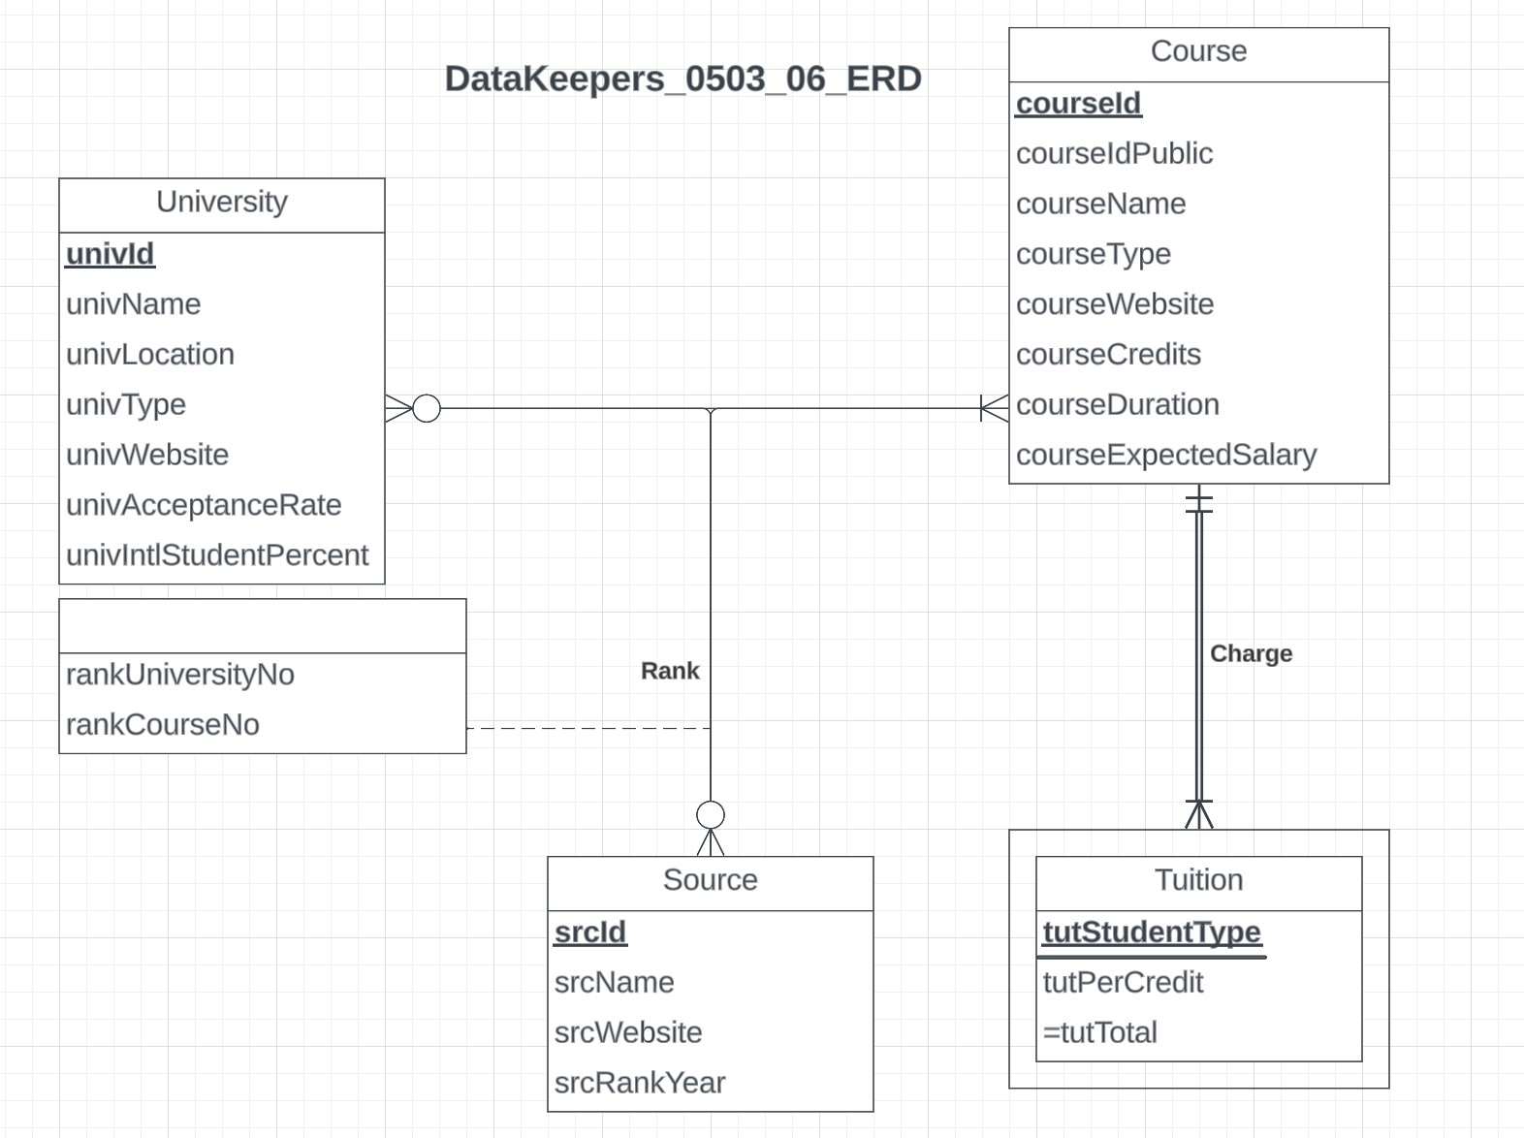
Conceptual Database Design
ERD Diagram for our Database

Slide 6
Relational Schema
University (univId, univName, univLocation, univType, univWebsite,univAcceptanceRate, univIntlStudentPercent)
Course (courseId, courseIdPublic, courseName, courseType, courseWebsite, courseCredits, courseDuration, courseExpectedSalary)
Source (srcId, srcName, srcWebsite, srcRankYear)
Tuition (courseId, tutStudentType, tutPerCredit)
Rank (srcId, univId, courseId, rankUniversityNo, rankCourseNo)

Slide 7
Business Rules
[R1] When a course is deleted from the database, the corresponding information in the Tuition should be deleted accordingly. [R2] When the information of a course is changed in the database, the corresponding course information in Tuition should be changed accordingly.
[R3] When a course is no longer in the database, the course information in Rank should be deleted from the database.
[R4] When a course is updated in Course, the corresponding information should be updated in the Rank table as well.
[R5] When the university information is deleted in a database, the corresponding information should be deleted in the Rank table as well.
[R6] When a university is updated in a database, the corresponding information in the Rank table should be updated as well.
[R7] When the source information is deleted in a database, the corresponding information in the Rank table should be deleted as well.
[R8] When a source is updated in a database, the corresponding information in the Rank table should be updated accordingly.

Slide 8
Referential Database Design
Relation | Foreign Key | Base Relation | Primary Key | Business Rule | Constraint: ON DELETE | Business Rule | Constraint: ON UPDATE
Tuition | courseId | Course | courseId | R1 | CASCADE | R2 | CASCADE
Rank | courseId | Course | courseId | R3 | CASCADE | R4 | CASCADE
Rank | univId | University | univId | R5 | CASCADE | R6 | CASCADE
Rank | srcId | Source | srcId | R7 | CASCADE | R8 | CASCADE

Slide 9
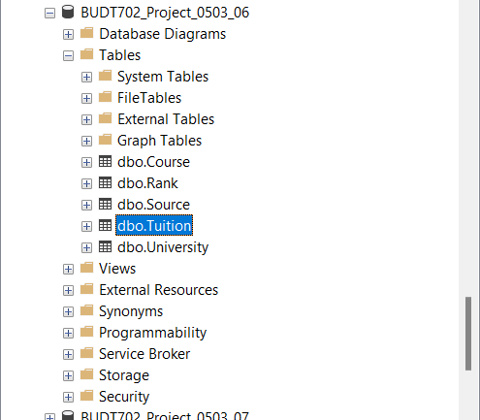
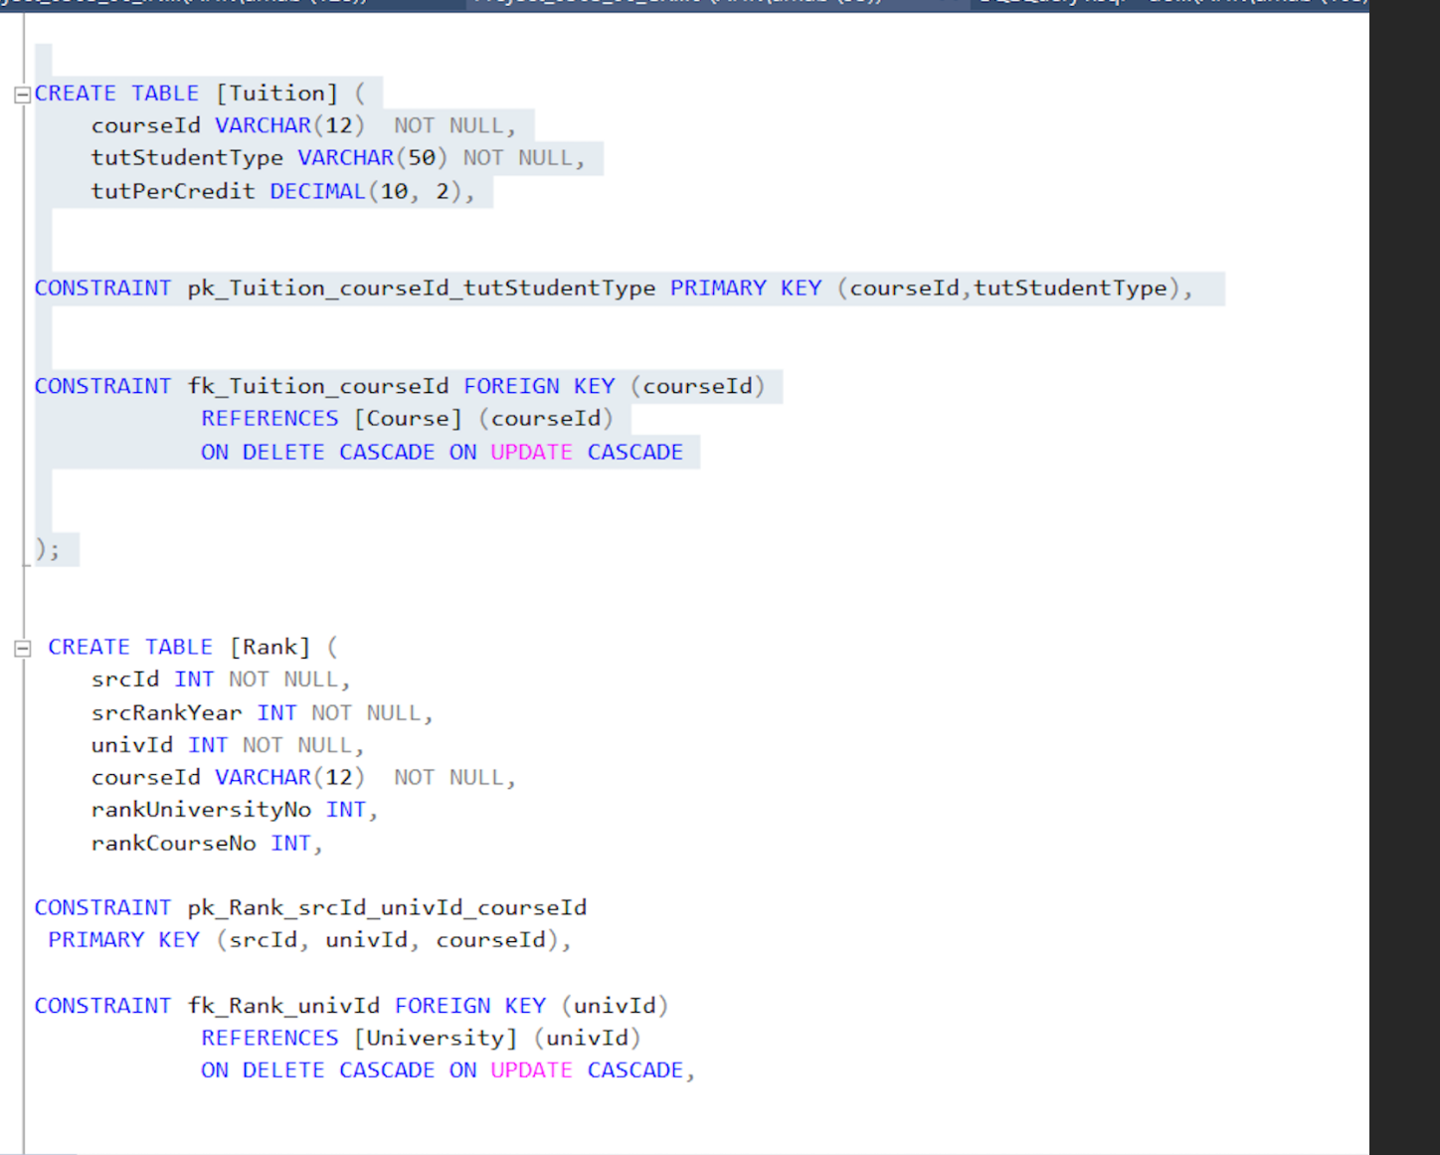
Database Design

Slide 10
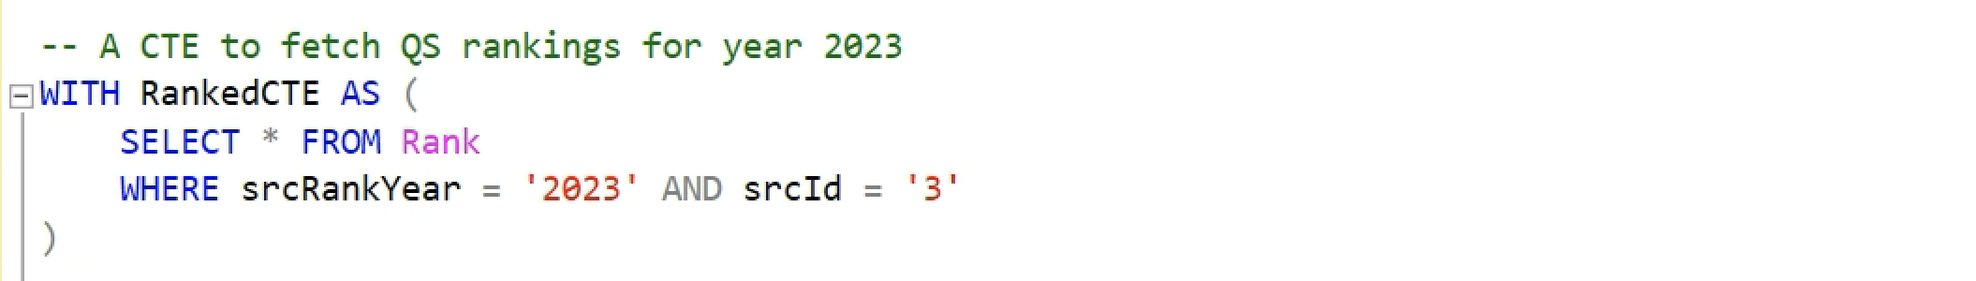
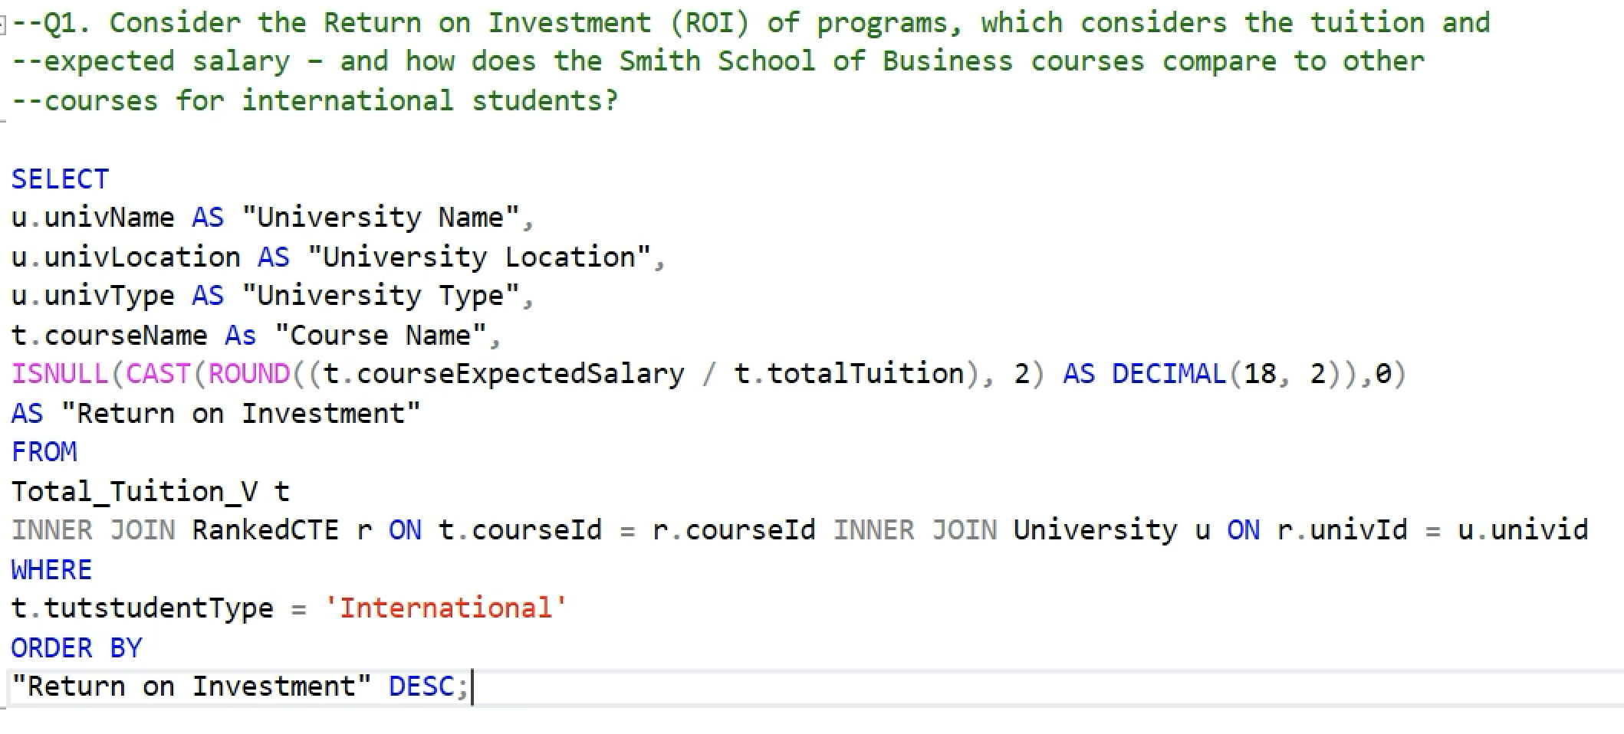
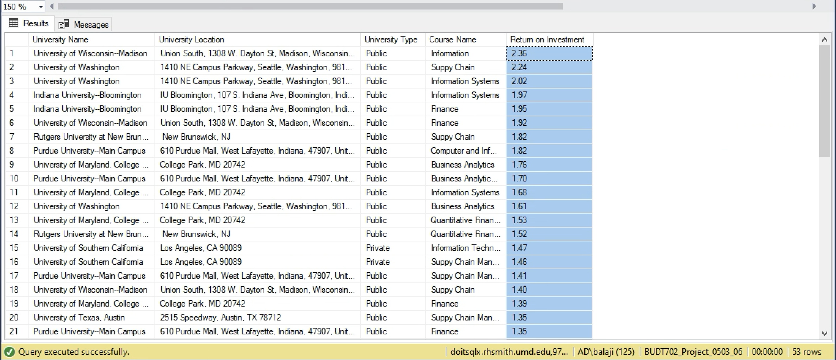
Business Transaction – 1 (ROI)
Q1. Consider the Return on Investment (ROI) of programs, which considers the tuition and expected salary – and how does the Smith School of Business courses compare to other courses for international students?
Creating a View

Slide 11
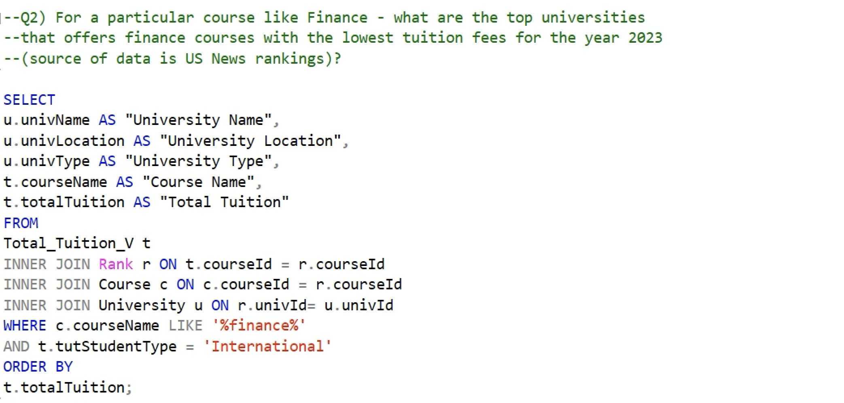
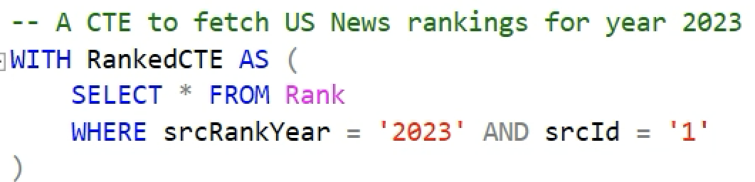
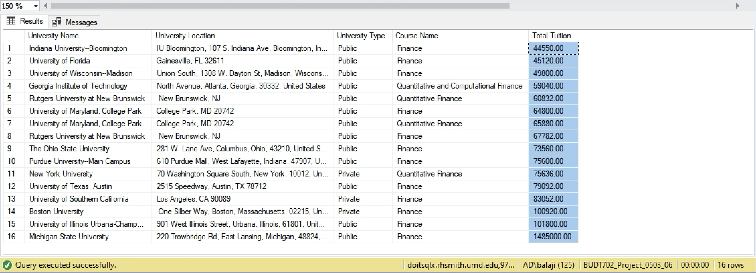
Business Transaction – 2 (Lowest Tuition)
Q2. For a particular course like Finance - what are the top universities that offers finance courses with the lowest tuition fees for the year 2023 (source of data is QS rankings)?

Slide 12
Thank You!

